Slide 1
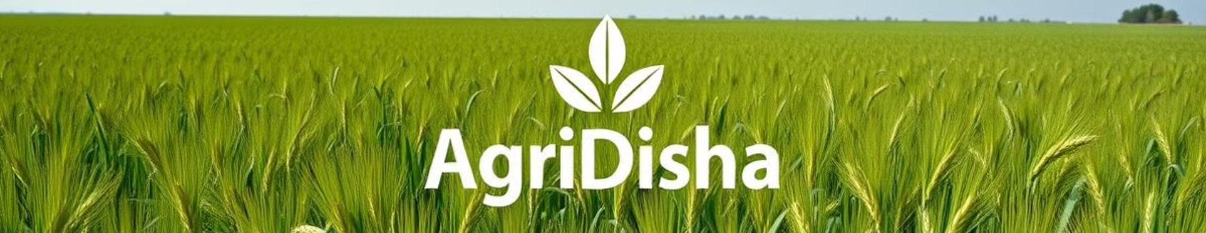
Introduction to AgriDisha
Here's an overview of AgriDisha, a comprehensive agriculture management system designed to streamline and improve agricultural practices for farmers, buyers.

Slide 2
Meet the Group
Siddhi Amup - 03
Shruti Hode - 30
Rutuja Kothare - 80

Slide 3
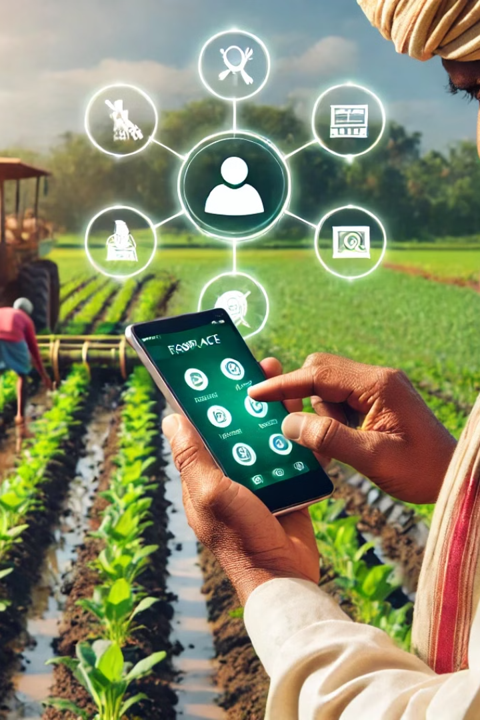
Project Synopsis
1
AgriDisha aims to bridge the gap between farmers and markets, enhancing agricultural productivity and accessibility.
2
Key features include a user-friendly online marketplace, resource management tools.

Slide 4

Technical Overview
Front-end development utilizes HTML/CSS for visual design and JavaScript for interactive user experiences.
Built on a robust PHP framework and MySQL database for data storage and management.
Responsive design using Bootstrap ensures optimal viewing across devices and screen sizes.
Leverages Google Translate API for multilingual support, fostering inclusivity in the platform.

Slide 5

System Design
User Registration: Farmers/Sellers and Buyers register with their details. The Admin approves or rejects farmer accounts.
1
2
Product Listing: Farmers/Sellers list their products with details, and the Admin approves products before they are visible to buyers.
Order Placement: Buyers can add products to their cart, checkout, and make payments.
3
4
Delivery: Farmers/Sellers update the delivery status, and buyers can confirm receipt.

Slide 6
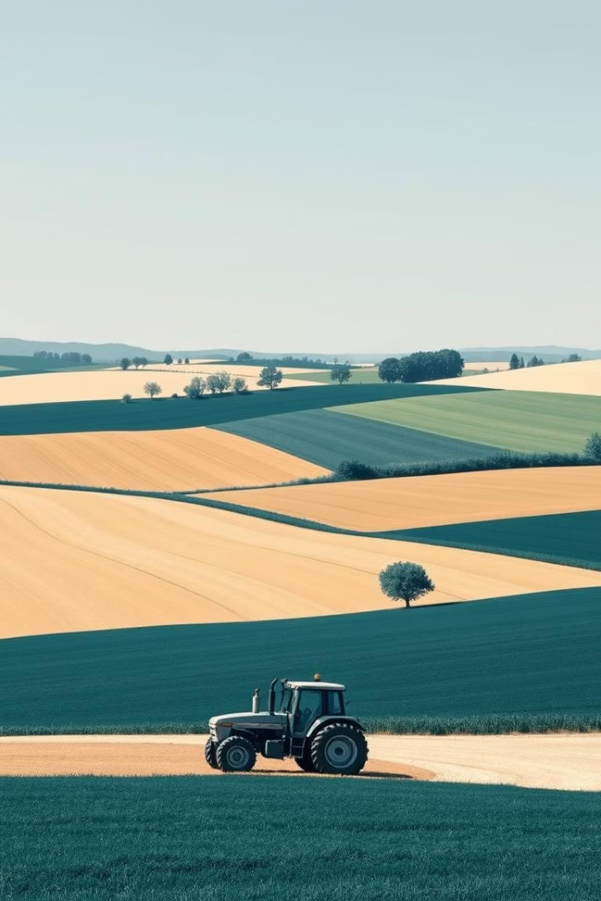
Conclusion and Future Plans
AgriDisha empowers farmers and buyers with a streamlined platform, facilitating agricultural growth and sustainability. We're continuously innovating to enhance the platform with advanced analytics, resource tracking, and expanded market reach.

Slide 7

Live Demo of AgriDisha
Join us for a live demonstration of AgriDisha!
http://localhost:8080/AgriDisha/

